Slide 1

West Virginia (WV) Rural Health Transformation Program (RHTP)
Webinar #2
July 9, 2026
‹#›

Slide 2
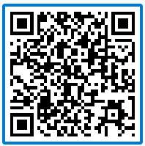
Agenda
What We Plan to Cover
 | Opening Remarks / Welcome & Introductions
 | RHTP Overview Recap
 | Program Progress and Key Milestones
 | Looking Ahead: What’s Next for RHTP
 | How to Apply
 | Closing Call To Action
6 | Open Q&A
1
2
Scan the QR code below to submit your questions for the Q&A:
3
4
5
6
7
‹#›

Slide 3
Welcome & Introductions
‹#›

Slide 4



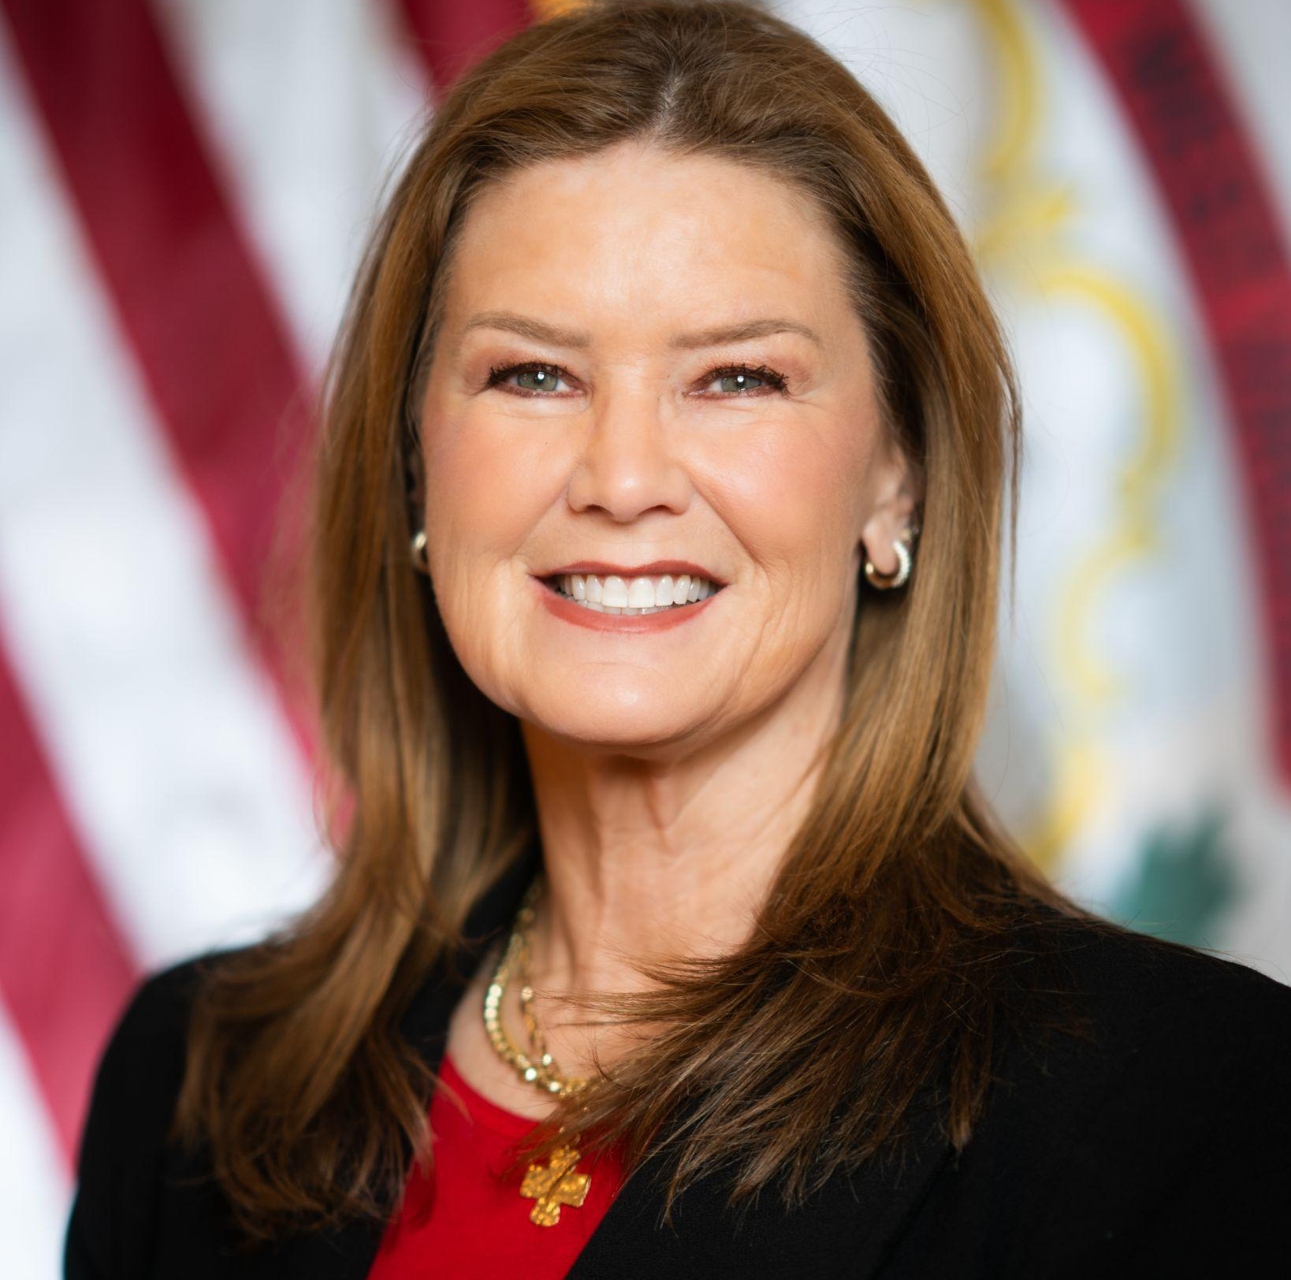
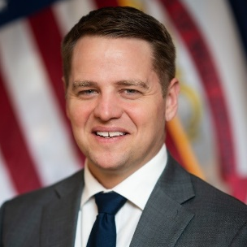

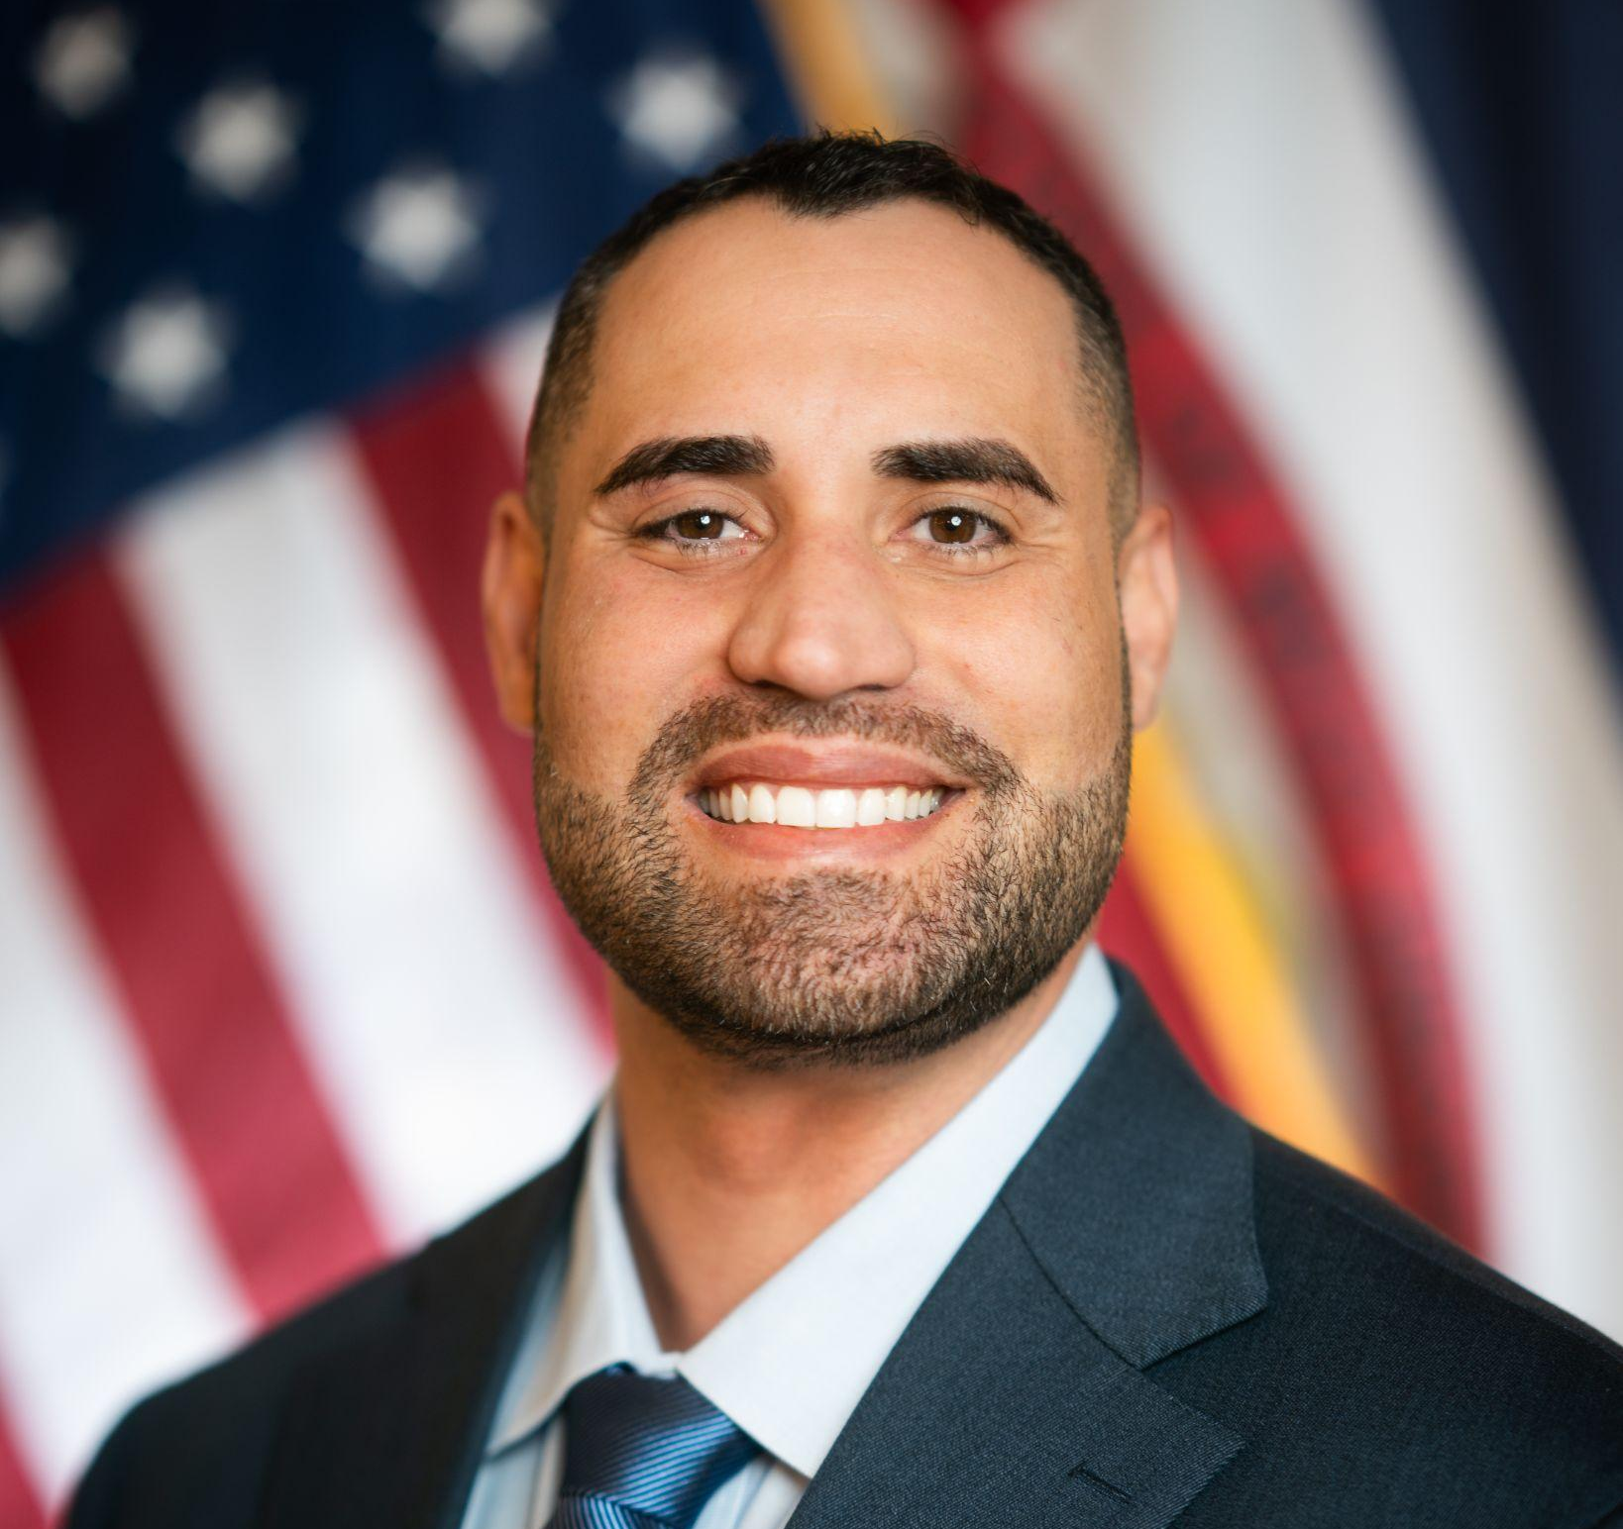

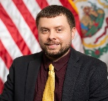










The RHTP Team
Your Speakers
Dr. Carrie Jeffries
RHTP Director
WVDH
Dr. Arvin Singh
Secretary of Health
WVDH
Anthony Purkey
Rural Health Link PM
WVDH
Sharon Covert
Health To Prosperity PM
WVDH
John Leite
Connected Care Grid PM
WVDH
Johnathan Frazier
Mountain State Care Force PM
WVDH
Mario Padron, DO, JD
Personal Health Accelerator PM
WVDH
Also Supported By
Michael Sheets
Procurement Officer & Grant Compliance PM
WVDH
Dr. Mark E. McDaniel
Acting State Health Officer & PH Commissioner WVDH
Justin Davis
Deputy Secretary of Health
WVDH
Bryan Rosen
Director of Purc. & Proc.
WVDH
Jack Fencl
Policy Consultant
Governor’s Office
Rae Bates
Exec. Assistant to the Secretary
WVDH
Melanie Boothe
Procurement Specialist WVDH
Stephanie King
Procurement Specialist WVDH
Gailyn Markham
Director of Comms. WVDH
Andrew Neely
Acting CIO
WVDH
Virginia Payne
General Counsel
WVDH
Shakita Micek
Assistant to the Secretary WVDH
Tara Buckner
CFO WVDH
TBD
SmartCare Catalyst PM
WVDH
Chelsea Coville
Communications Manager WVDH
Lorna Morris
Administrative Assistant to RHTP
WVDH
Agne Pack
Data Analyst
WVDH
TBD
Data Analyst
WVDH
TBD
Program Evaluation & Quality Assurance PM
WVDH
‹#›

Slide 5
RHTP Overview Recap
‹#›

Slide 6
Opening Remarks
West Virginia is a state with a rich history that is used to innovating out of necessity, building strong local partnerships, and finding solutions that work in rural settings.
Community, collaboration, and stewardship are values at the heart of West Virginia and at the center of how our State is approaching the Rural Health Transformation Program.
CMS has funded West Virginia with $199.5M for Year 1 out of 5 to align resources, partners, and strategy to turn long‑standing barriers into opportunities for improved health and economic stability for the State.
RHTP funding is designed to transform how care is delivered, rather than maintain current approaches without change. Strong proposals highlight innovative approaches that improve efficiency, expand access, or enhance outcomes, going beyond simply increasing capacity.
This funding gives West Virginia the opportunity to be a proving ground for how rural states can design integrated, sustainable health systems that improve outcomes while supporting economic participation and long‑term community stability.
Scan the QR code to submit your questions for the Q&A:
‹#›

Slide 7
WV RHTP Vision and Priorities Recap
PROGRAM VISION
To make West Virginia healthier and stronger by improving health outcomes, strengthening the rural workforce, and building a self-reliant economy through prevention, innovation, and partnerships.
STRATEGIC PRIORITIES (Aligned with the national Make America Healthy Again (MAHA) initiative)
Address health-related barriers to workforce participation
Establish West Virginia as a center for rural health technology innovation and partnership
Strengthen rural healthcare access while building a sustainable care delivery system
Scan the QR code to submit your questions for the Q&A:

Slide 8


Our Core Initiatives
Connected Care Grid
Rural Health Link
Mountain State Care Force
West Virginia’s RHTP implementation will be centered on 7 key initiatives
SmartCare Catalyst
Health to Prosperity
Personal Health Accelerator
HealthTech Appalachia
Scan the QR code to submit your questions for the Q&A:

Slide 9
Example of Flywheel in Action
The individual is connected to local and virtual care through telehealth and remote patient monitoring for chronic disease management.
Data flows into the statewide data spine, allowing care teams to track outcomes over time
As health stabilizes, the individual is placed back to work through health‑to‑work programs and can continue to have care monitored through worksite clinics
Connected Care Grid
Health to Prosperity
Staffing is improved and available to support expanded care access for the individual and others with similar conditions..
Working-Age Adult with Chronic Disease
When in‑person visits or diagnostics are needed, unified medical transportation ensures the patient can get to care reliably.
Mountain State Care Force
Rural Health Link
The individual has the option to participate in a clinical trial for new technologies that would help manage their condition.
The individual is connected to nutrition and wellness programs, including food‑as‑medicine and community‑based prevention initiatives
Health Tech Appalachia
Personal Health Accelerator
Scan the QR code to submit your questions for the Q&A:

Slide 10
Program Progress and Key Milestones
‹#›

Slide 11
Our Progress Thus Far
Milestones Achieved Since We Last Met…
March 30: Received legislative approval on bill requiring doctors to complete continuing nutrition education.
May 13: Released first six (6) funding opportunities totaling ~$29M
May 26: Held second Advisory Panel
June 18: Finalized priority metrics for CMS reporting
April 13: Held first Advisory Panel
May 19-20: Hosted CMS Site Visit
May 28: Held first HTA Investment Panel
June 23 & 25: Held third Advisory Panel and second HTA Panel
Ongoing Activities…
Designing and releasing funding opportunities, supported by dashboards that track progress, milestone-based payments, and fund utilization across 35+ opportunities. Also addressing stakeholder and prospective applicant questions through streamlined Q&A forms.
Driving stakeholder engagement through a growing 850+ subscriber listserv and ongoing communications to keep partners informed, aligned, and actively involved
Following standardized application review processes by reviewing all application responses, using an in-depth evaluation process, and advancing decisions aligned with compliance and ethical standards
Scan the QR code to submit your questions for the Q&A:
‹#›

Slide 12
RHTP Expenditures Progress Tracking
Overall RHTP Status | On Track
On Hold/
Not Started
Completed
On-target
At risk
Significant risk
Procurement Funds Posted and/or Under Review
Procurement Funds Upcoming to be Posted
40%
60%
40%
60%
20%
Today
80%
20%
80%
Today
0%
100%
0%
100%
$142.2M / $182.0M
$39.5M / $182.0M
Represents all funding that has been posted publicly on wvOASIS and/or is undergoing the application/decision process. | Represents all funding currently moving through the procurement pipeline, from initial program design to final review for posting.
Note: Administrative costs are excluded from these figures; therefore, total does not sum to $199.5M.
Scan the QR code to submit your questions for the Q&A:
‹#›

Slide 13
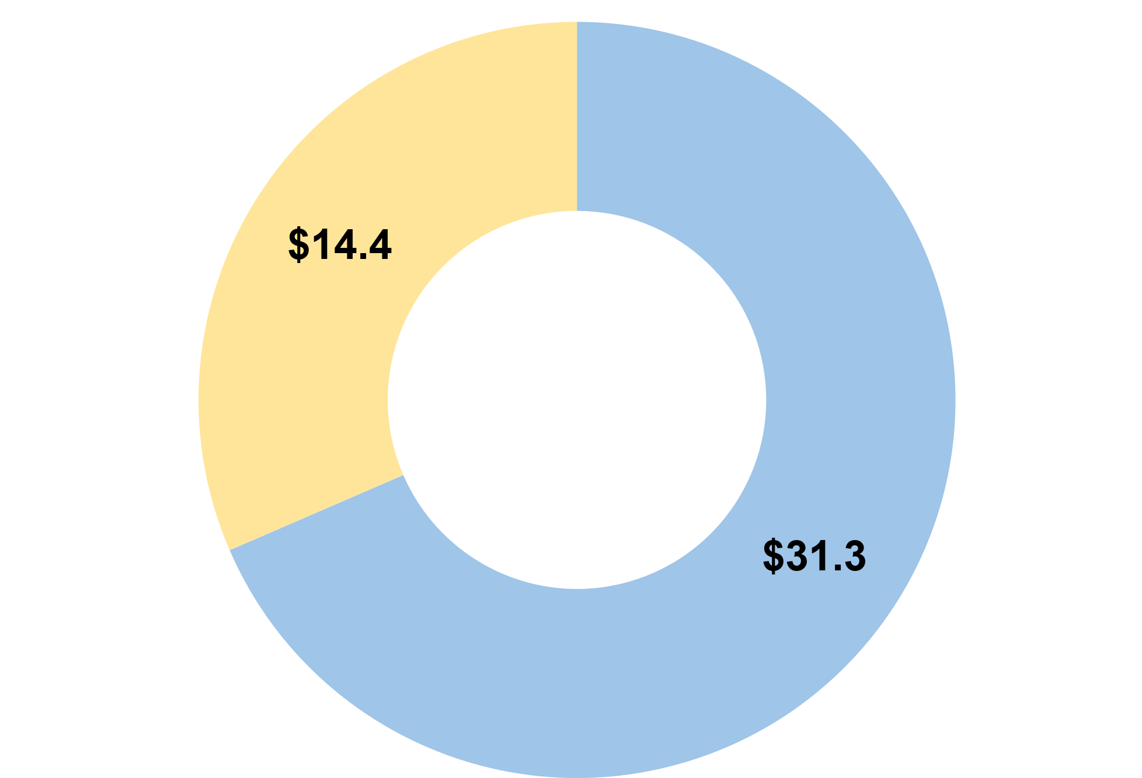
Connected Care Grid
OVERVIEW
STATE RANKINGS
50TH State in Broadband Access
49% counties are maternal care deserts
Fragmented and limited data sharing
Connected Care Grid (CCG) expands access to healthcare by strengthening virtual and local care delivery – bringing care closer to where residents live. It will support access point expansion, bring more providers into virtual networks, and integrate user-friendly scheduling platforms to support access across care types.
Source: WV RHTP CMS Application
FUNDING OPPORTUNITY PROGRESS
A
Funding Remaining:
A Request for Information (RFI) was previously released to plan and for two (2) additional solicitations. This remaining funding will focusing on expanding access to care through remote patient monitoring (RPM).
A
Total CCG Y1 Allocation
$45.9M
Funding Under Application/ Decision Process:
~$31.3M in funding opportunities have been posted soliciting statewide Health Information Exchange, Telehealth Capabilities, Data Spine, Interoperable Provider Directory and Scheduling Platform, and Emergency Medical Services (EMS) Community Paramedicine Programs.
B
B
Scan the QR code to submit your questions for the Q&A:
‹#›

Slide 14

Rural Health Link
OVERVIEW
STATE RANKINGS
Most West Virginia counties have populations with <2,500 residents connected primarily by winding, rural roads.
20+ counties have no public transportation.
Rural Health Link (RHL) focuses on addressing transportation barriers by unifying medical and community transportation into a one-stop system. It will connect citizens to transport options and increase public and private transit capacity to reduce missed appointments due to mobility issues.
Source: WV RHTP CMS Application
FUNDING OPPORTUNITY PROGRESS
Funding Remaining:
All RHL funding remains and will be posted in five (5) solicitations focusing on expanding local mobility through EMS collaboratives, public transportation, and vehicle acquisition, while simplifying rural access to care via a mobility technology platform and regional hubs with coordinated support.
A
A
Total RHL Y1 Allocation
$13.8M
$13.8M
Scan the QR code to submit your questions for the Q&A:
‹#›

Slide 15

HealthTech Appalachia
OVERVIEW
STATE RANKINGS
2x National average in overdose deaths
20-45% above national average in COPD, CVD, Diabetes prevalence
HealthTech Appalachia (HTA) incubates and scales breakthrough technologies to improve rural health outcomes and productivity, while attracting private investment to the state. This initiative fosters tech-enabled innovations for chronic disease management and substance use disorder recovery, positioning West Virginia as a hub for health innovation.
Source: WV RHTP CMS Application
FUNDING OPPORTUNITY PROGRESS
Funding Under Application/ Decision Process:
All $18.8M in HTA funding is under application evaluation review/decision process. One lead administrator will be awarded to serve as the fiscal agent and independent evaluator. Funds will be sub-awarded to support implementation of HealthTech-enabled initiatives statewide. Aimed to fund start-ups, sub-grantees can expect to hear more about the application process for these funds at a later date.
B
B
Total HTA Y1 Allocation
$18.8M
$18.8M
Scan the QR code to submit your questions for the Q&A:
‹#›

Slide 16
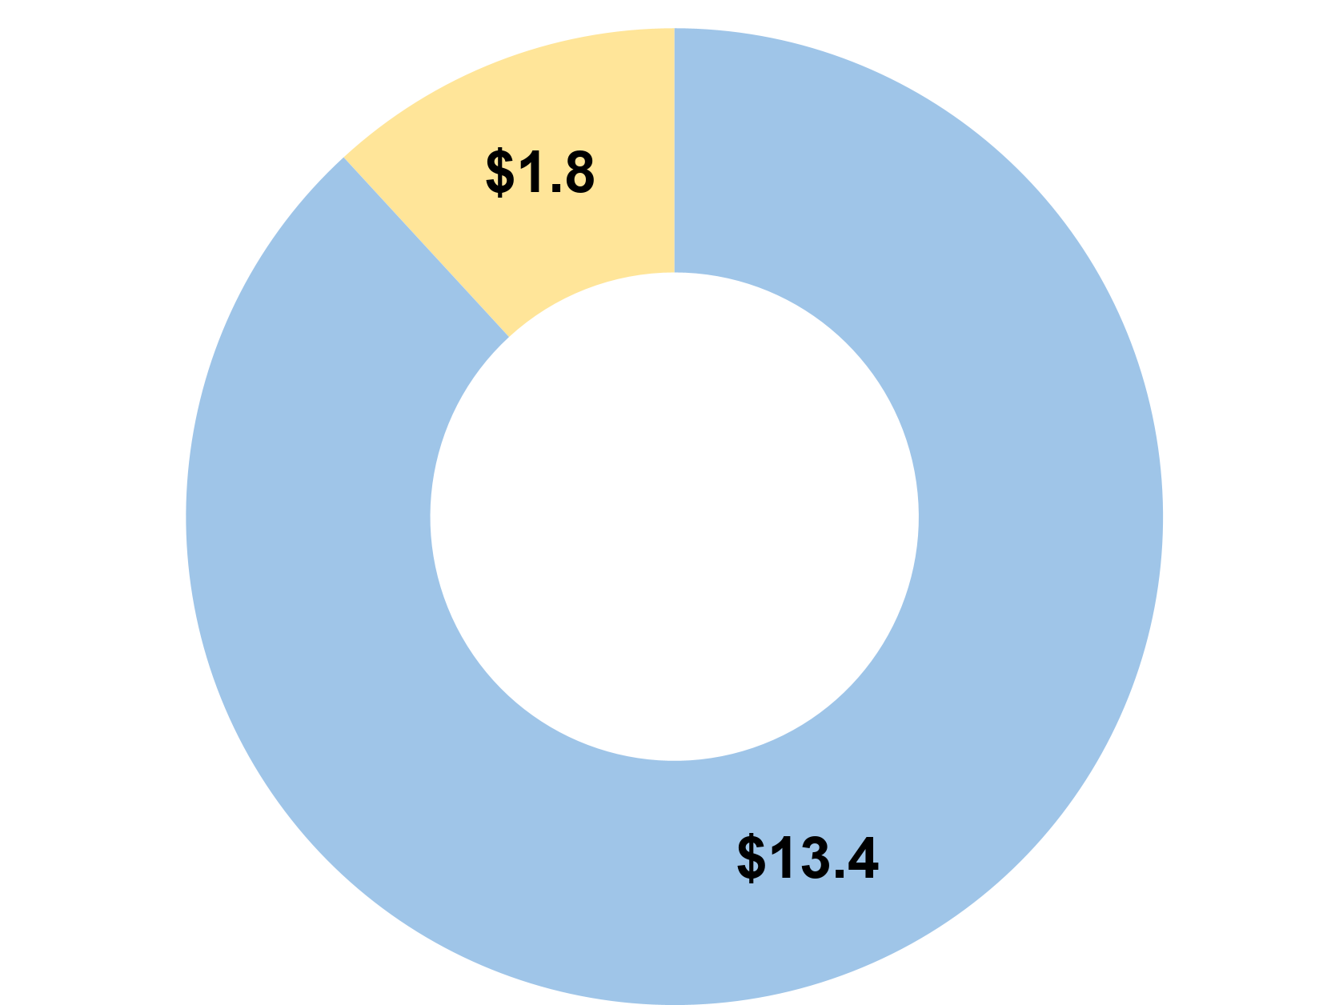
Mountain State Care Force
OVERVIEW
STATE RANKINGS
55/55 Counties are HPSA shortage areas
20% counties with a population to health worker ratio greater than 40:1 (2x US avg.)
Mountain State Care Force (MSCF) is designed to recruit, train, and retain healthcare workers for West Virginia's future, aiming to alleviate workforce shortages in rural counties. This includes growing local talent pipelines, funding new rural residency slots, and providing incentives for healthcare professionals to serve in shortage areas.
Source: WV RHTP CMS Application
FUNDING OPPORTUNITY PROGRESS
A
A
Funding Remaining:
One (1) final Rotational Staffing Pools solicitation will be posted seeking awardee(s) to improve workforce availability and fill staffing gaps
Total MSCF Y1 Allocation
$15.2M
B
B
Funding Under Application/ Decision Process:
Six (6) solicitations totaling $13.4M in funding have been posted and are under application evaluation. Opportunities focus on strengthening and sustaining the healthcare workforce pipeline through early exposure, training and education capacity, recruitment, retention, and ongoing workforce development.
Scan the QR code to submit your questions for the Q&A:
‹#›

Slide 17
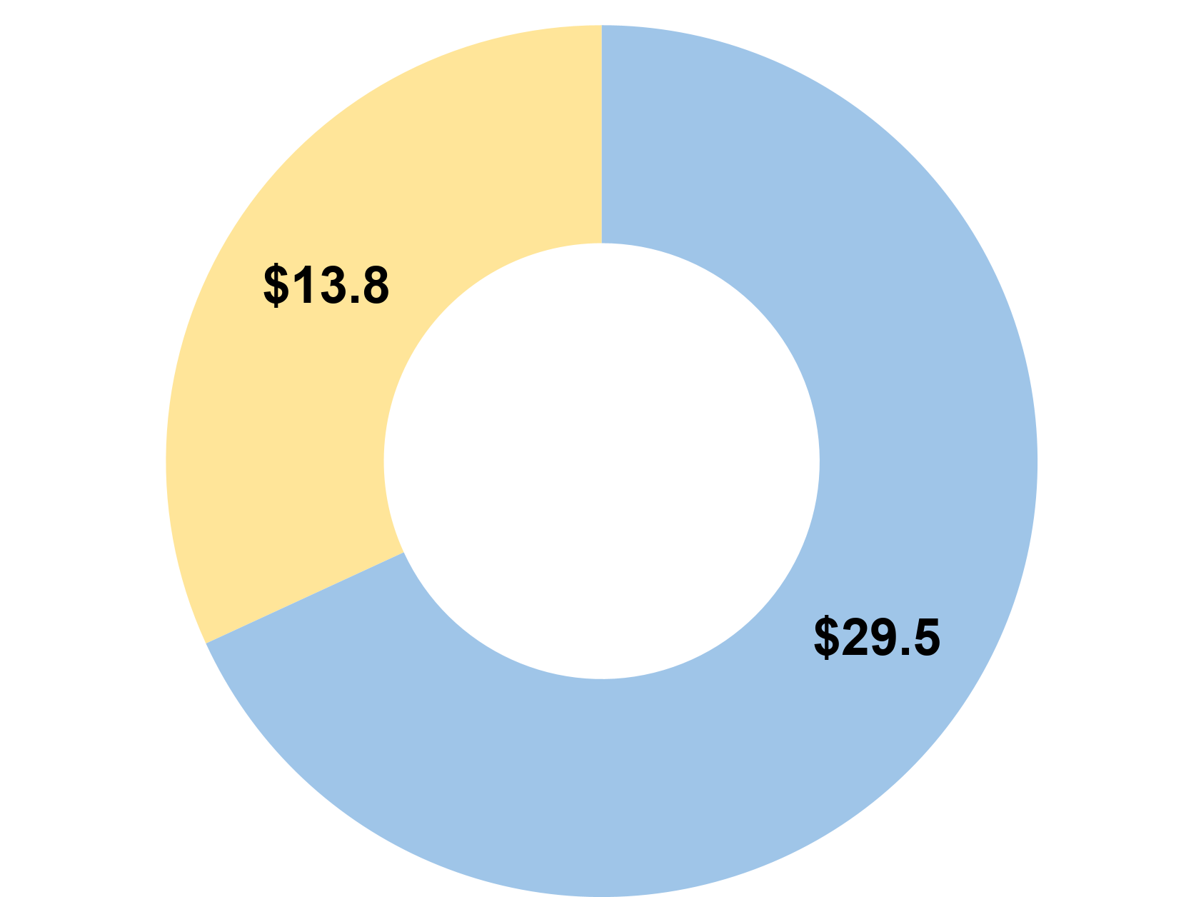
Smart Care Catalyst
OVERVIEW
STATE RANKINGS
2nd Highest per capita cost in the nation for hospital services
Smart Care Catalyst (SCC) equips rural providers with payment and data tools to streamline operations, reduce administrative burdens, and enhance patient care. It aims to improve financial sustainability and promote value by transitioning providers towards value-based care models that reward outcomes.
Source: WV RHTP CMS Application
FUNDING OPPORTUNITY PROGRESS
A
A
Funding Remaining:
Remaining $13.8M in funding will be distributed across four (4) additional solicitations focusing on advancing Value Based Care (VBC) models.
Total SCC Y1 Allocation
$45.6M*
B
B
Funding Under Application/ Decision Process:
One (1) solicitation for Provider Productivity Support Fund received applications and is under application evaluation review. Awardee(s) will receive funding to improve provider productivity and reduce administrative burden across healthcare settings.
*Note: The total SCC Y1 Allocation variance accounts for the administrative funds retained for state use under the PPSF.
Scan the QR code to submit your questions for the Q&A:
‹#›

Slide 18
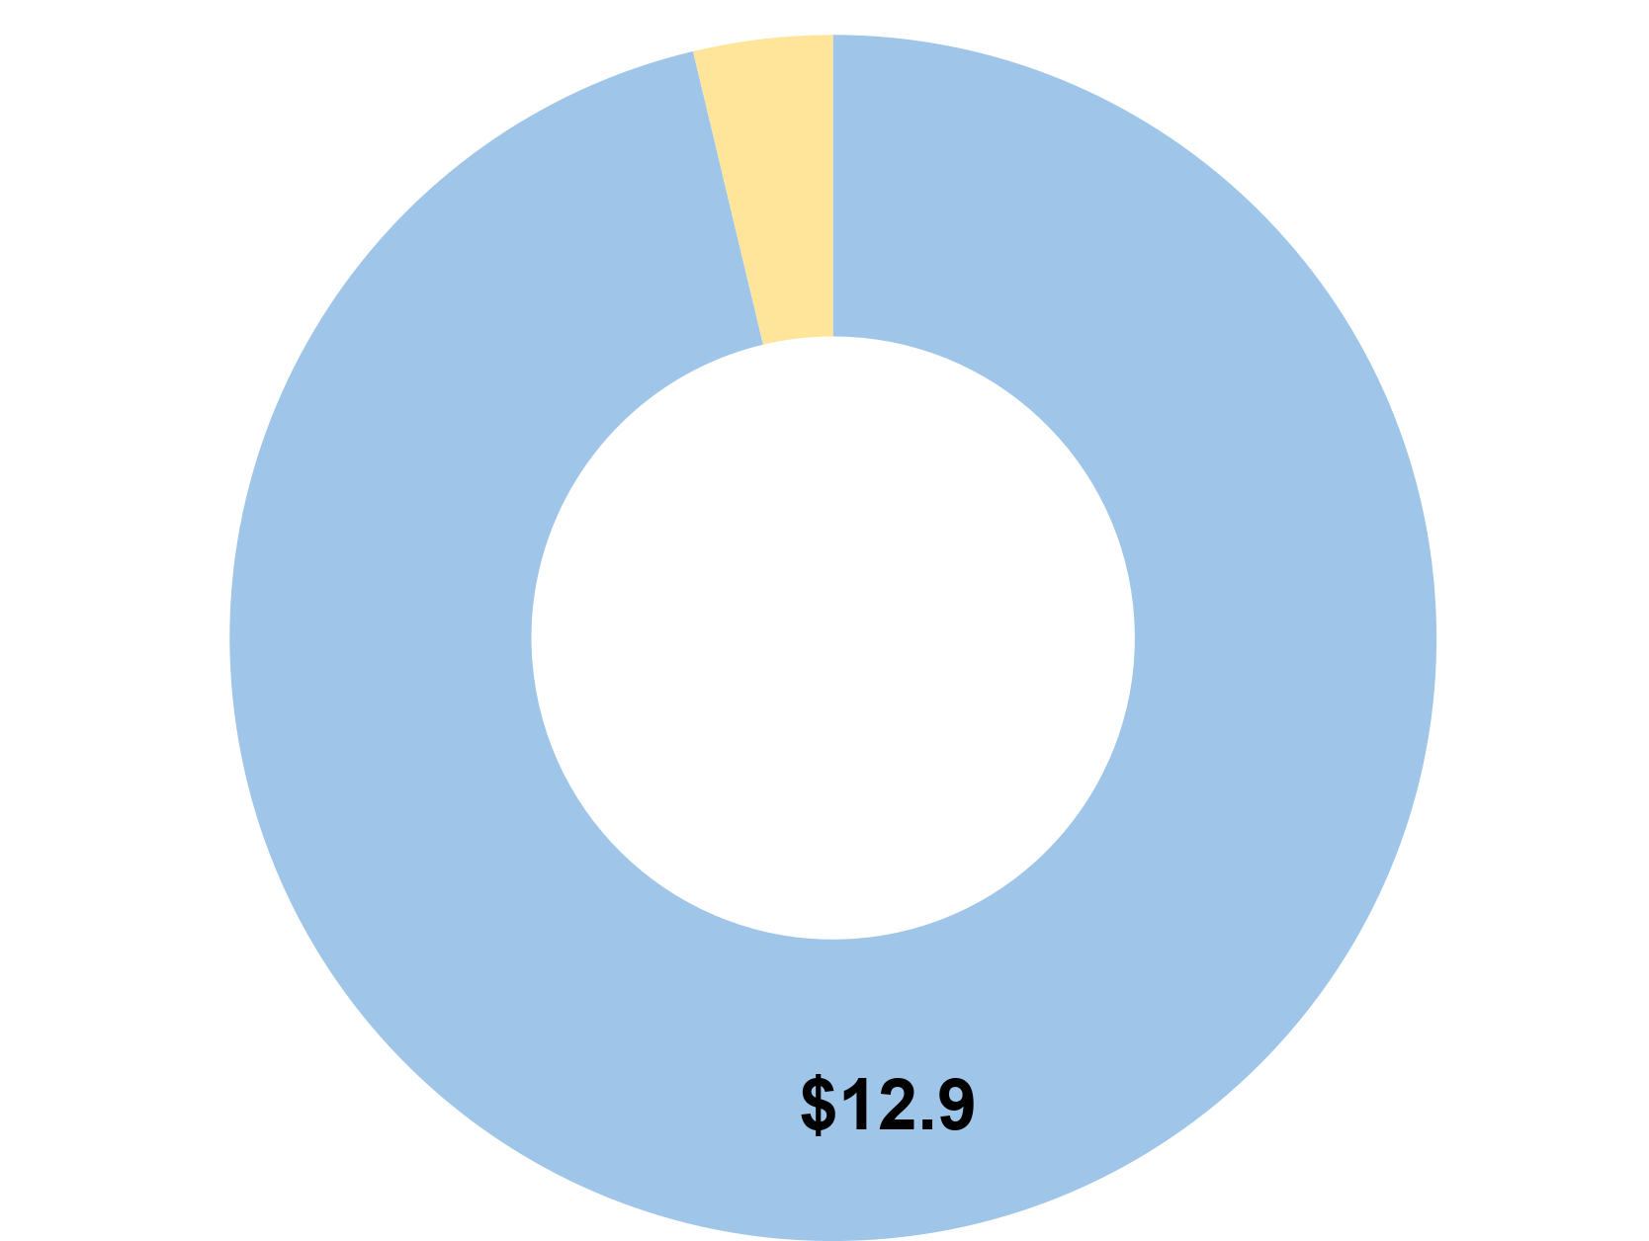
Health to Prosperity
OVERVIEW
STATE RANKINGS
54.3% Workforce participation rate
#1 reason for not working is due to poor health or disability
Health To Prosperity (HTP) connects recovery, care management, and employment programs to help West Virginians overcome health barriers to workforce participation. This initiative supports economic productivity by helping adults with chronic conditions and behavioral health challenges return to work and move towards employer-sponsored coverage.
Source: WV RHTP CMS Application
FUNDING OPPORTUNITY PROGRESS
A
Funding Remaining:
Remaining $0.5M in funding is planned to be distributed later this summer. Specific focus area to be determined.
A
Total HTP Y1 Allocation
$13.4M
B
B
Funding Under Application/ Decision Process:
$12.9M in HTP funding has been posted across three (3) solicitations focused on helping individuals stay healthy and return to work by expanding worksite-based care models and supporting health-to-work programs for chronic conditions and behavioral health needs.
Scan the QR code to submit your questions for the Q&A:
‹#›

Slide 19
Personal Health Accelerator
OVERVIEW
STATE RANKINGS
14% Food insecurity rate
Highest adult obesity rate (41% vs. 37% nationally)
Personal Health Accelerator (PHA) empowers healthy living through education, incentives, and programs like "food-as-medicine" to target prevalent chronic conditions such as obesity, diabetes, and hypertension. It aims to build statewide wellness infrastructure and integrate wellness promotion and tracking into medical data systems to improve population health.
Source: WV RHTP CMS Application
FUNDING OPPORTUNITY PROGRESS
Funding Under Application/ Decision Process:
All $29.0M in PHA has been posted across three (3) solicitations focused on improving population health outcomes, expanding prevention and wellness programs, and enabling closed-loop referral systems to better connect individuals to wellness services and track follow-through on care.
Total PHA Y1 Allocation
$29.0M
B
B
Scan the QR code to submit your questions for the Q&A:
‹#›

Slide 20
Looking Ahead: What’s Next for RHTP
‹#›

Slide 21
Program-Level Implementation Areas
Getting Funds Out the Door
Beginning Implementation
To date, 20+ funding opportunities have been released and 10+ additional funding opportunities will be released across key RHTP pillars—targeting care access expansion, healthcare workforce development, and digitally enabled, outcomes-driven care delivery—on a rolling basis over the next month.
RHTP plans to release all funding opportunities this summer and begin implementation on a staggered timeline, focusing on the highest impact activities first.
Transitioning from procurement to active partnership as opportunities are released.
Preparing to deploy funding for immediate, measurable impact on the ground.
Integrating data into the State Data Spine for real-time accountability and making this a requirement for all grantees and awardees of funds.
Scan the QR code to submit your questions for the Q&A:

Slide 22
Upcoming Funding Opportunities
While several solicitations have already been posted, many more are on the way. The table below highlights future funding opportunities still to be announced. High-level previews of upcoming opportunities will also be shared via the RHTP website.
Initiative | Focus Area(s)
Connected Care Grid | Expanding inpatient remote patient monitoring Expanding outpatient remote patient monitoring
Mountain State Care Force | Creating and/or supporting rotational staffing pools to improve workforce availability and fill staffing gaps
Rural Health Link | Strengthening emergency medical services (EMS) collaboratives for coordinated regional care delivery Expanding healthcare access through public transportation and non-emergency mobility solutions Supporting vehicle acquisition to expand mobility and transportation capacity Building a unified health-mobility platform technology and establishing integrations
Smart Care Catalyst | Designing and administering statewide value-based payment models, including standardized model design and aligned provider incentives Supporting provider onboarding and participation in value-based care (VBC) models through implementation support and operational enablement Providing technical assistance, infrastructure support, and start-up funding to enable provider readiness and participation in VBC models Expanding access to Program of All-Inclusive Care for the Elderly (PACE)
Health to Prosperity | Focus area to be determined
Scan the QR code to submit your questions for the Q&A:

Slide 23
How to Apply
‹#›

Slide 24
How to Apply
For additional information and to access the wvOASIS portal, please navigate to the WV RHTP website linked here: Rural Health Transformation Program | WV Department of Health
AFA/Grant
RFP
Find Opportunity: Locate the Announcement for Funding Availability (AFA) on the wvOASIS Vendor Self Service (VSS) portal, listed under “Grant Funding Opportunities.”
1
Find Opportunity: Locate the Request for Proposal (RFP) on the wvOASIS Vendor Self Service (VSS) portal, where it is published for vendors.
1
Determine Eligibility: Carefully read the AFA to confirm that your organization is eligible and to understand the intended use of the funds and other key requirements.
Determine Eligibility: Carefully read the full RFP document to confirm that your organization is eligible and to understand the scope of work, technical requirements, and submission instructions.
2
2
3
Submit Application: If eligible, complete and submit the grant funding application directly through wvOASIS VSS portal.
3
Submit Proposal: For larger dollar procurements, bids are either submitted in the wvOASIS system (Requests for Quotation) or in hard copy (RFP, EOI).
Await Award Notification: Once submitted, the application will enter the state’s review process. If successful, a grant award will be created and an agreement will be sent for signature.
Await Award Notification: Once submitted, the proposal will enter the state’s review process. If successful, an award will be issued through the portal.
4
4
Scan the QR code to submit your questions for the Q&A:

Slide 25
What Strong Applications Demonstrate
Strong applications clearly demonstrate how funding will enable new or enhanced ways of delivering care, supported by the capabilities below…
Operational Readiness | Show ability to stand up and run the program using a concrete operating model (e.g., workflows, staffing, partners, tools, timelines), not a purely conceptual framework.
Speed to Launch | Demonstrate an ability to begin implementation rapidly and deliver early milestones within State-defined timeframes (e.g., pilots or initial implementation shortly after award).
State Data System Integration | Demonstrate the ability to support statewide data integration, standardized reporting, and real-time State access to program and outcome data.
Long-Term Sustainability | Outline a realistic plan for sustaining the program beyond grant funding, including long-term funding mechanisms, operational efficiencies, and integration with broader systems or markets.
Metric Accountability | Execute against State milestones and metrics, with mechanisms to monitor progress, address underperformance, and meet State and CMS performance expectations.
Fiscal Stewardship & Compliance | Articulate how proposed activities complement, rather than duplicate, existing or reimbursable services and do not replace existing funding or staffing, and demonstrate readiness to manage grant funds responsibly, including line-item budgeting, financial reporting, audit readiness, and compliance with State and CMS requirements.
Innovation Signal | Show ability to stand up and run the program using a concrete operating model (e.g., workflows, staffing, partners, tools, timelines), including how new approaches will be integrated into existing operations.
Scan the QR code to submit your questions for the Q&A:

Slide 26
Allowable Costs
Allowable costs are defined as expenses that are permitted by CMS because they directly support the goals of the grant program.
Clinical Care & Prevention | Technology & Infrastructure
Prevention & Chronic Diseases – Strategies to improve chronic disease management. Appropriate Care Availability – Efforts to evaluate and strengthen the healthcare system. Behavioral Health – Expanding access to mental health & substance use services. | IT Advances – Software, hardware, and cybersecurity solutions supporting RHTP initiatives. Consumer Technology Solutions – Patient-facing tools and telehealth expansion. Capital Expenditures & Investments – Minor facility renovations & equipment acquisition.
Innovation & Collaboration | Workforce & Training
Innovative Care – Designing and implementing new value-based care models. Foster Collaboration – Building strategic partnerships between rural providers. Provider Payments – Covering uncompensated care, services that fill a coverage gap, or performance in alternative payment models tied to outcomes | Workforce Development – Initiatives to attract, train, and retain clinical staff. Training & Technical Assistance – Hands-on education for implementing new tools.
It is important to remember that the RHTP is a federal program and RHTP funding is subject to federal cost principles, found at Title 2, Code of Federal Regulations, Part 200, Subpart E (2 CFR 200 Subpart E), which guides how expenses may be treated.
Applicants should review the specific solicitation document for any additional restrictions.
Scan the QR code to submit your questions for the Q&A:

Slide 27
Unallowable Costs
Unallowable costs are defined as expenses that the funder does not permit because they do not directly support the goals of the grant program or violate funding rules.
Pre-award costs Services or supports that are the legal responsibility of another entity Independent research and development Cosmetic or experimental procedures under 45 CFR 156.4004 Expenditures used to finance the non-federal share of other federal programs Supplanting existing state, local, tribal, or private funding New construction or major capital improvements Payments for clinical services reimbursable by insurance Salaries or wage supports for clinicians at facilities with non-compete clauses Services prohibited under Social Security Act (SSA), Section 2105
Example 1: Payments for Clinical Services Reimbursable by Insurance
Allowable: Supporting non-billable care coordination and patient support activities as part of a new chronic disease management program (Focus: Building new care coordination capacity)
Unallowable: Paying for a patient's routine lab work or doctor's visit that is already billable to insurance. (Focus: Paying for a standard, reimbursable service)
Example 2: New Construction or Major Capital Improvements
Allowable:Cosmetic upgrades to existing space and adding technology to support a new or expanded telehealth service model (Focus: Expanding services in existing space)
Unallowable: Building a brand-new wing or a separate building to house the new telehealth center. Purchasing new laptops because the current ones are old. (Focus: New, ground-up construction,)
Scan the QR code to submit your questions for the Q&A:

Slide 28
Expense Spending Caps
Expense Type | Limitation or Spending Cap
Administrative Costs | Capped at 10% of the total award, including administrative costs for subrecipients. Includes both indirect costs and direct administrative costs. Salaries are considered an administrative cost unless the individual is performing direct programmatic work.
Electronic Medical Record (EMR) System Replacement | Limited to no more than 5% of the total award per budget period for replacing the existing EMR system when a certified system existed before September 1, 2025.
Rural Tech Catalyst Fund | Limited to 10% of the total award or $20 million, whichever is lower.
Salaries & Wages | Funds cannot be used to support clinician salaries or wages for facilities that have non-compete clauses. Non-clinician salaries may be allowable only under the following conditions: Directly ties to an approved RHTP initiative Not used to supplant existing funding Properly documented and allocable to the project U.S. Department of Health & Human Services (HHS) Executive Level II Salary Cap applies. Any amount paid above the salary cap will be required to be paid with non-federal funds.
Provider Payments & Payments for Medical Services | Provider payments capped at 15% of total award per budget period. Funds cannot be used to cover services that could be reimbursed by insurance. Certain medical procedures are explicitly not eligible
Per CMS’ FAQs, Question III.45, states and subrecipients must maintain detailed budget documentation, demonstrating that costs are:
Necessary
Reasonable
Allocable to specific RHTP initiatives
Consistent with the NOFO and 2 CFR Part 200
Scan the QR code to submit your questions for the Q&A:

Slide 29
Closing Call To Action
‹#›

Slide 30
What to Expect After Applying
Once submitted, the application will enter the State’s review process:
Each solicitation typically receives 30-50 applications.
A team of three (3) reviewers is responsible for evaluating all applications.
Each application requires approximately 2-4 hours to review thoroughly.
The State follows a standardized scoring and evaluation process so that every application is reviewed fairly and thoughtfully.
Applicants should expect to receive award decisions this summer. For selected applicant(s), an award will be created and an agreement will be sent for signature.
 | Application review by State team
 | Decision memo drafted and signed
 | Statement of Work (SOW) developed
 | SOW refined with selected awardee(s)
 | Documents entered into State system
 | Cross-departmental State review
6 | Award issued for awardee(s) signature
 | Chief Financial Officer review and signature
 | Final contract executed and released
1
2
3
4
5
6
7
8
9
We thank you for your patience as the State reviews a high volume of applications. We appreciate your interest and look forward to potential future partnerships.
Scan the QR code to submit your questions for the Q&A:

Slide 31
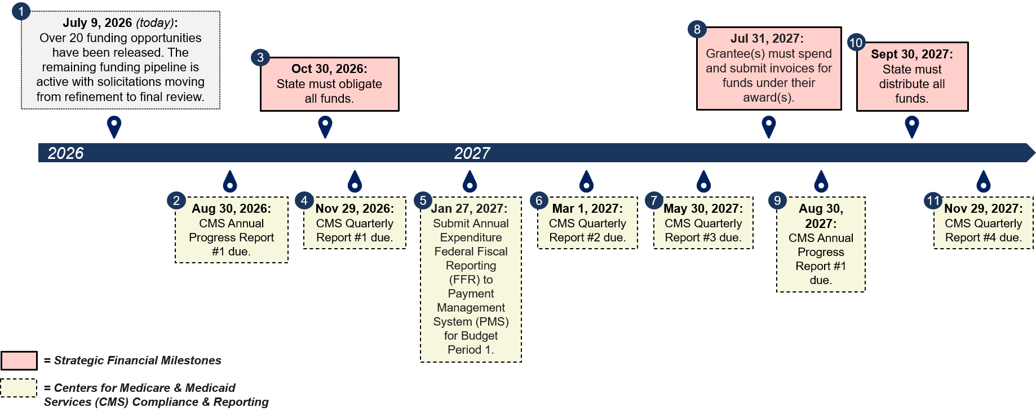
Financial Planning & Reporting Timeline
Scan the QR code to submit your questions for the Q&A:
‹#›

Slide 32
How West Virginians Can Participate
We will maintain transparency in our communications with all stakeholders as the Program progresses. You may find all RHTP news, updates, and resources on our program website: Rural Health to Transformation Program | WV Office of the Governor Patrick Morrisey.
Future Solicitations
Keep an eye out for upcoming Request for Proposals (RFP) and grant announcements. We will be seeking partners to help us build a better healthcare future for rural West Virginians.
Register as a Vendor
To be eligible for contracting opportunities, register your organization in the WVOasis vendor system. This is a crucial step to ensure you are ready when announcements are made.
Stakeholder Meetings
Attend our upcoming stakeholder meetings to learn more about the RHTP, ask questions, and provide your valuable feedback.
RHTP Listserv
Stay up-to-date with the West Virginia RHTP by signing up for our listserv to get the latest announcements, updates, and information sent directly to your inbox.
Scan the QR code to submit your questions for the Q&A:
‹#›

Slide 33
Q&A
Scan the QR code below to submit your questions for the Q&A:
‹#›

