Slide 1

Rural Health Transformation (RHT) Program: Health as the Foundation of West Virginia’s Economic Strength March 24th, 2026
1

Slide 2
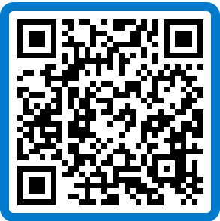
Agenda
What We Plan to Cover
 | Opening Remarks / Welcome & Introductions
 | RHTP Program Overview
 | Public, Private, and Community Partners
 | CMS Guidance & Funding Limitations
 | Procurement & Grant Opportunities
 | Closing Call To Action
 | Open Q&A
1
2
3
Scan the QR code below to submit your questions for the Q&A:
4
5
6
7

Slide 3
Welcome & Introductions
3

Slide 4
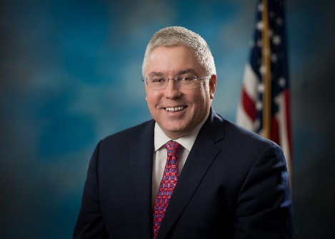
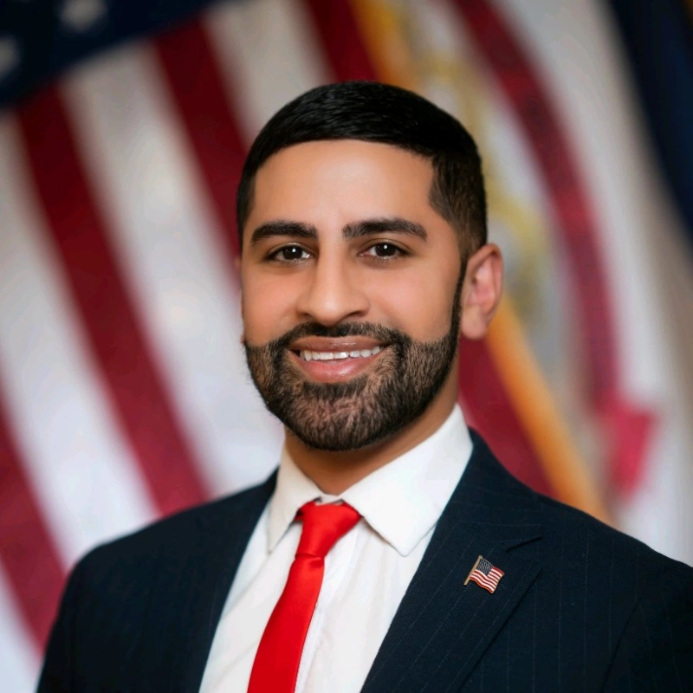
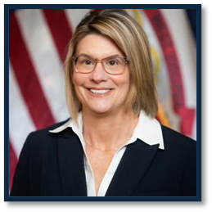


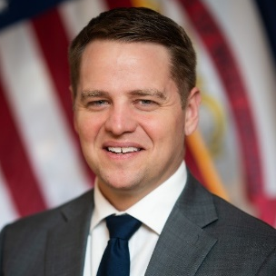
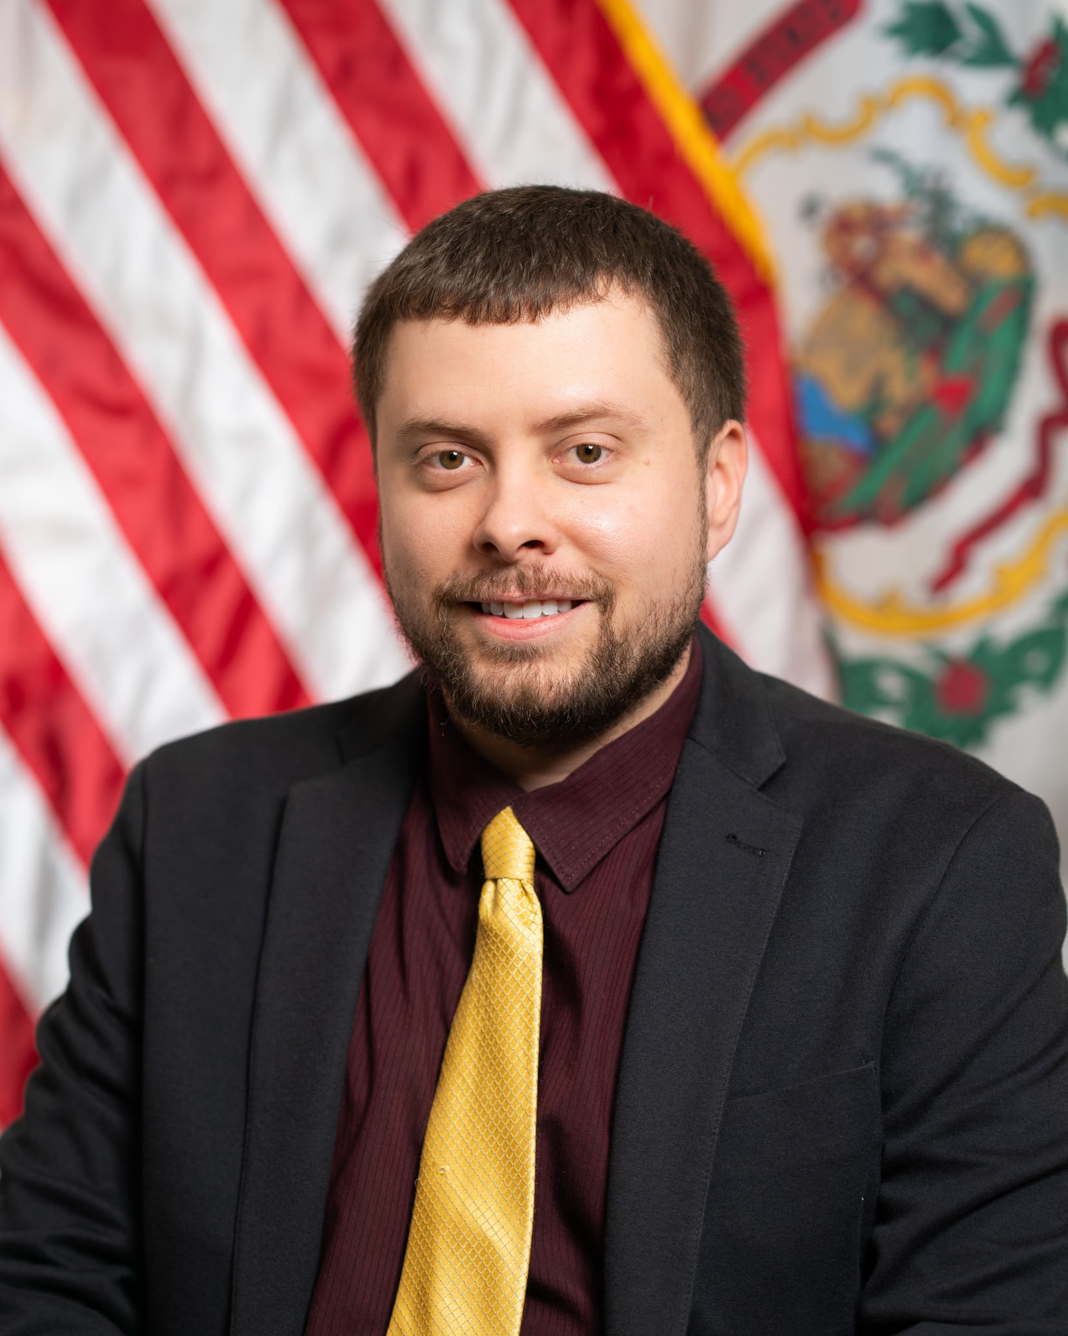
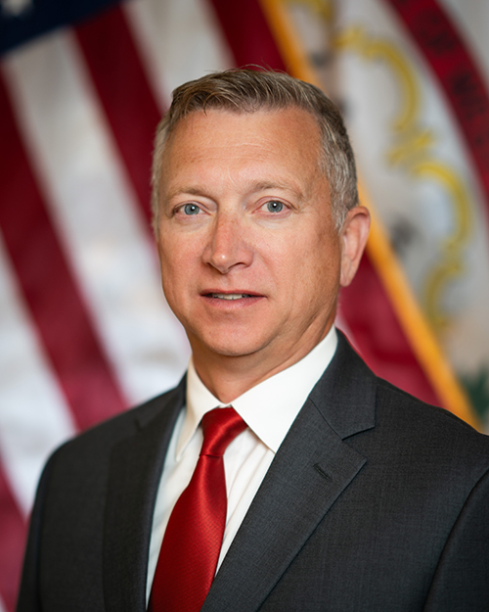


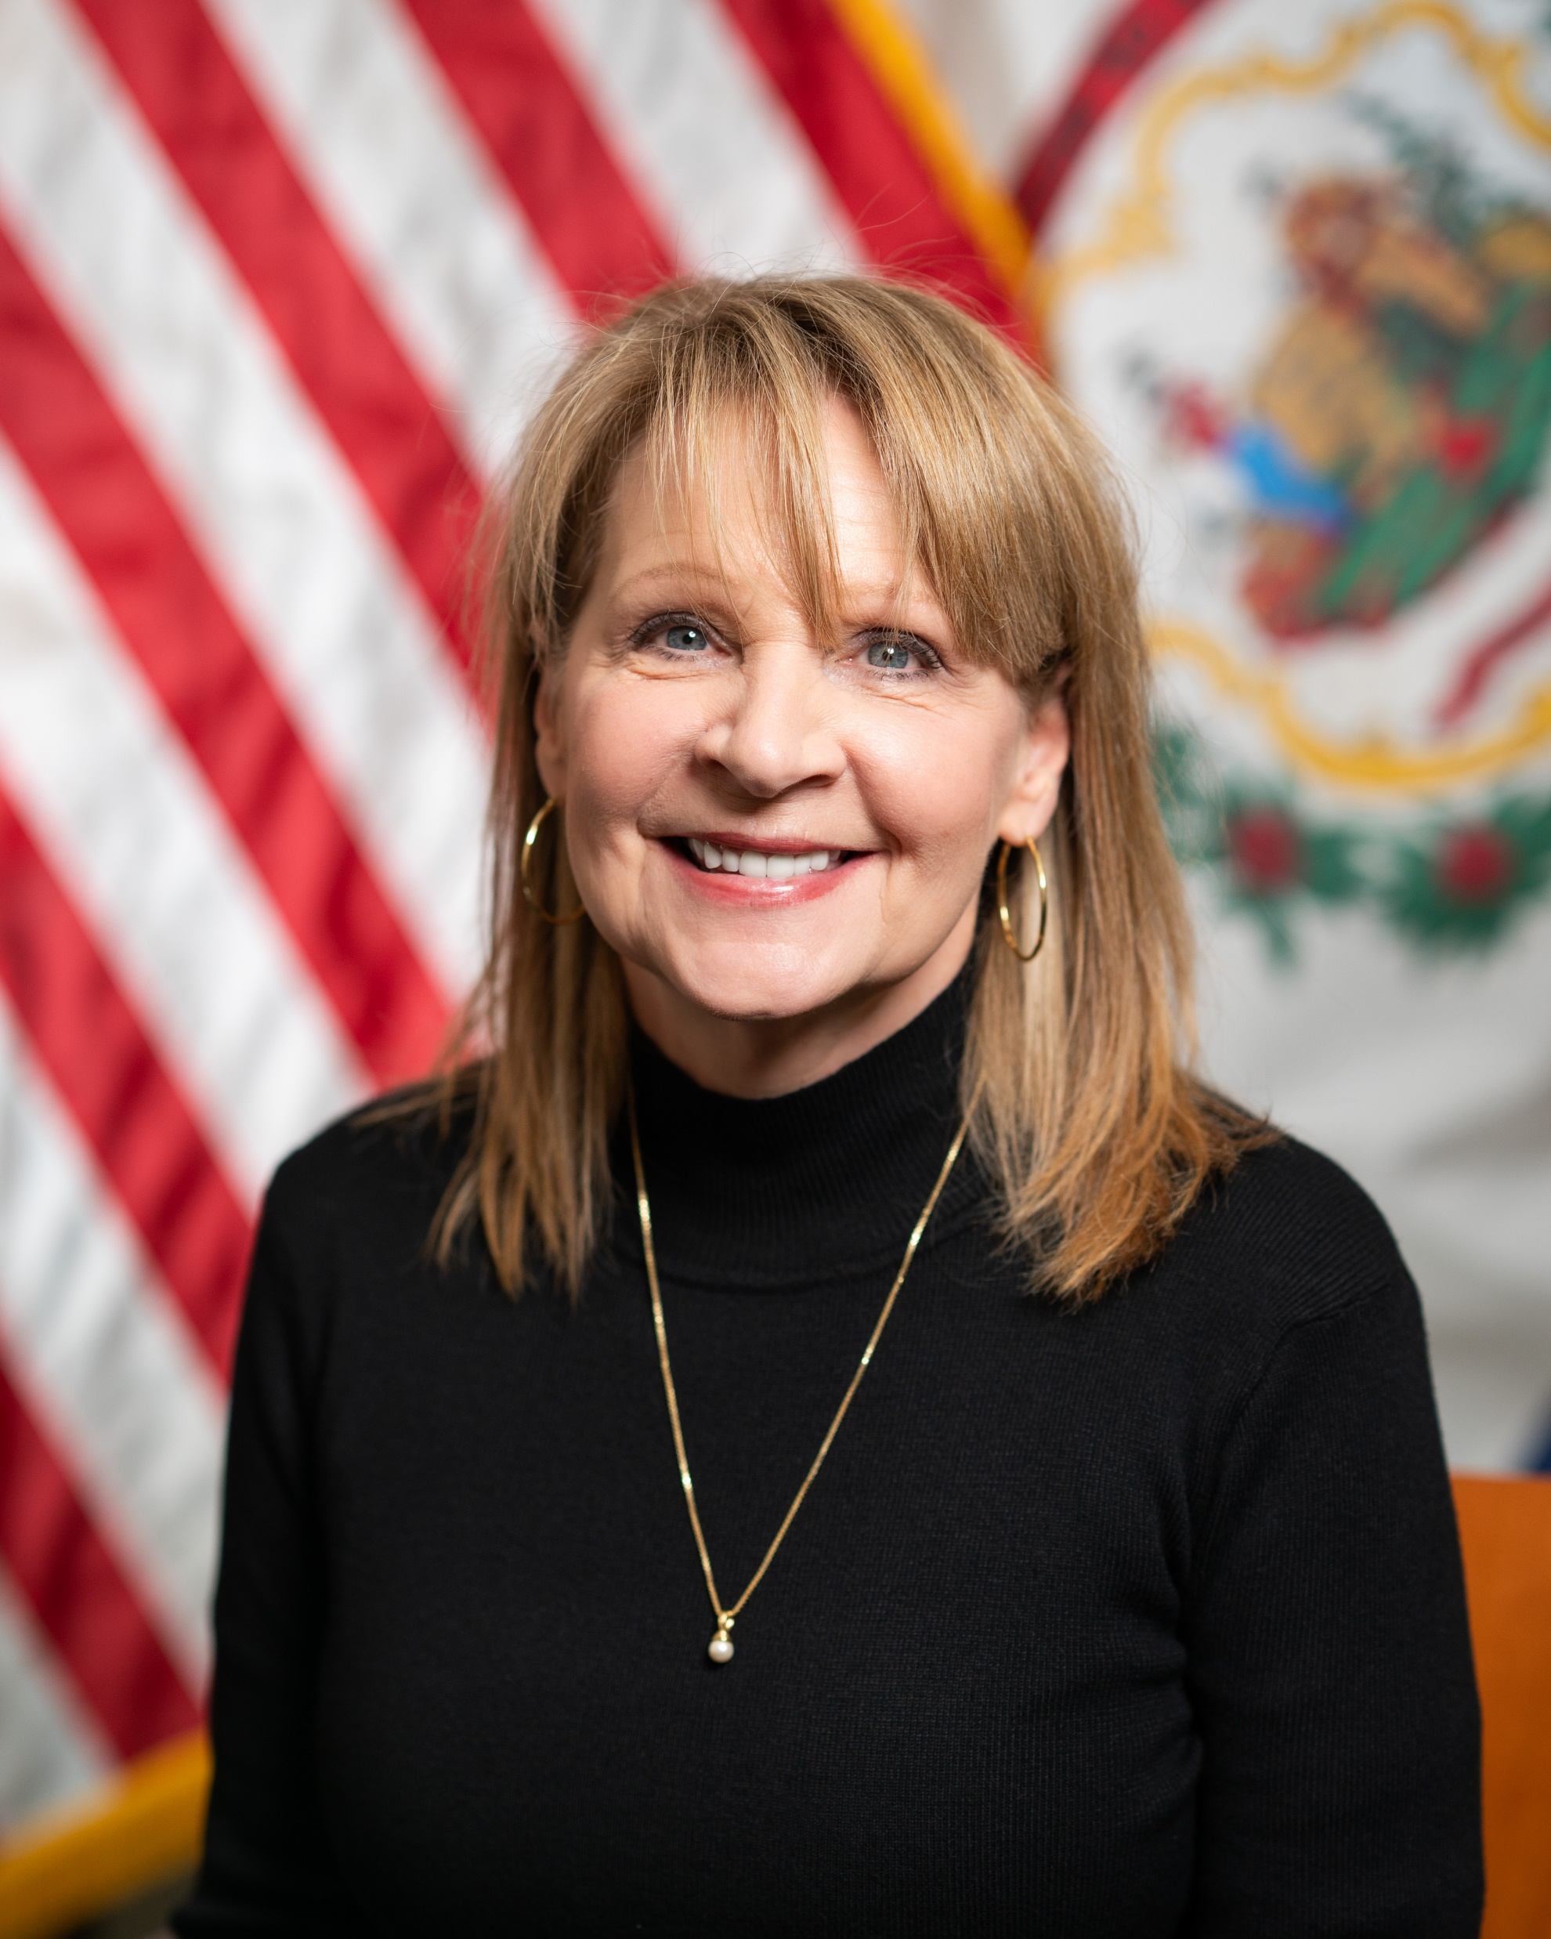
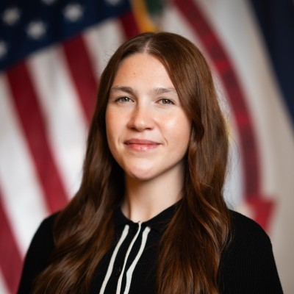



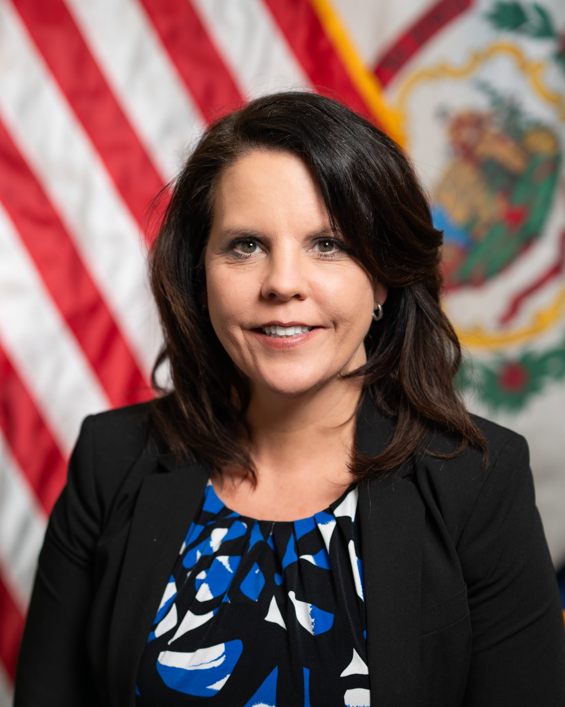
Introductions
Your Speakers Today
Patrick Morrisey
Governor
State of West Virginia
Arvin Singh
Secretary of Health
WVDH
Dr. Carrie Jeffries
RHTP Director
WVDH
RHTP Team (Continued)
Soumya Prasad, MD
RHTP Deputy Director
WVDH
Michael Sheets
RHTP Procurement Officer
WVDH
John Leite
Connected Care Grid Program Manager
WVDH
TBD
Grant Compliance PM
Onboarding
Stakeholder Comms Manager
TBD
Rural Health Link PM
TBD
Mountain State Care Force PM
TBD
Smart Care Catalyst PM
TBD
Personal Health Accelerator PM
Onboarding
Health To Prosperity PM
TBD
HealthTech Appalachia PM
Supported By
Justin Davis
Acting CommissionerBPH
Dr. Mark E. McDaniel
Acting State Health Officer
Bryan Rosen
Director of Purc. & Proc.
Jack Fencl
Policy Consultant
Governor’s Office
Rae Bates
Exec. Assistant to the Secretary
Gailyn Markham
Director of Comms. WVDH
Andrew Neely
Acting CIO
Virginia Payne
General Counsel
Shakita Micek
Assistant to the Secretary
Tara Buckner
CFO WVDH
Also, currently in partnership with KPMG

Slide 5
RHTP Program Overview
5

Slide 6
West Virginia’s RHTP Vision and Priorities
PROGRAM VISION
To make West Virginia healthier and stronger by improving health outcomes, strengthening the rural workforce, and building a self-reliant economy through prevention, innovation, and partnership.
STRATEGIC PRIORITIES (Aligned with the national Make America Healthy Again (MAHA) initiative)
Address health-related barriers to workforce participation
Establish West Virginia as a center for rural health technology innovation and partnership
Strengthen rural healthcare access while building a sustainable care delivery system

Slide 7
RHTP’s Distinctive Needle Movers
West Virginia’s RHT Program focuses on achieving the following target objectives & metrics by:
CMS Strategic Goal | Objectives | Highlighted 5-Year Target Metrics
Make Rural America Healthy Again | Improve control of chronic disease | ​Improve control of chronic disease (incl SUD, diabetes, hypertension, CVD, COPD, asthma) by 5-10% Reduce prevalence of adult obesity by 4%
 | Help citizens overcome health barriers to workforce participation | ​5% reduction in percent of individuals citing health as a barrier to employment ​Increase workforce participation rate by 2 percentage points
 | Deploy targeted strategies to mitigate Neonatal Abstinence Syndrome (NAS) birth rates | ​Reduce instance of NAS births by 5-10%
Sustainable Access | Improve access to reduce avoidable ED/inpatient use | ​Reduce avoidable ED visits by 15-20%
 | Provide satisfactory wait times and patient experience | Improve patient satisfaction with access by 5% as measured by CAHPS scores
Workforce Development | Increase provider capacity and productivity to see patients | Reduced average outpatient appointment wait times by 20% for key provider types
 | Improve rural clinician retention | Achieve workforce retention rate of 2/3 (5 yrs in supported role)
Innovative Care Model | Improve rural healthcare’s financial sustainability and value | Reduce total cost of care growth rate by 1/3
Tech Innovation | Increase adoption of evidence-based solutions that improve outcomes | Over 50% of HealthTech investments are demonstrating clinical and cost outcomes
Addressing state-wide health challenges through community engagement and empowering individuals through education to make informed decisions about their well-being.
Driving economic sustainability by incubating and accelerating start-up rural health technologies.
Building strong public-private partnerships to foster collective action and shared ownership of the State’s health goals.

Slide 8







Our RHTP Flagship Initiatives
West Virginia’s RHTP implementation will be centered on 7 key pillars that will work together as an integrated system to address West Virginia’s most pressing rural health challenges.
Rural Health Link
Mountain State Care Force
HealthTech Appalachia
FLYWHEEL OF IMPACT
Smart Care Catalyst
Personal Health Accelerator
Connected Care Grid
Health To Prosperity Pipeline

Slide 9
Overview of CMS Funding
CMS will make annual awards to states over the course of five years. Investments must be sustainable after RHTP Federal funding concludes.
Total federal funding of $50 billion to be allocated to approved states over five fiscal years
Baseline funding of $25 billion will be evenly distributed among all states
Workload funding of $25 billion will be allocated to states based on a variety of scored factors
FFY2026 | FFY2027 | FFY2028 | FFY2029 | FFY2030 | FFY2031
State Award Year 1
State Award Year 2
Note: Each award period extends into the following federal fiscal year, allowing states the flexibility of an extended liquidation period to utilize funds until the end of the subsequent fiscal year, except for funding States may receive in FY 2032.
State Award Year 3
State Award Year 4
State Award Year 5

Slide 10


Where the $199.5M Will Go
CMS has awarded $199.5M to fund WV RHTP for Year 1 of the program, which will be distributed across the following key areas:
Investing in Healthcare Innovation
Connecting residents to timely care
4
1
$199.5M Flywheel of Impact
49th
Transition to a healthier workforce, improved outcomes, and innovative economy that can sustain itself in the long-term
West Virginia’s rank in overall health status out of the 50 States
3
2
-2.5 years
Strengthening community health & economic activity
Building capacity for coordinated, quality care
West Virginia’s life expectancy is 2.5 years lower than the national average

Slide 11
CMS Annual Performance Evaluation & Rescoring
Beginning in 2028, CMS will rescore states based on their metric attainment and reallocate any unspent funds across states.
Additionally, states are at risk of fund reclamation for expenditures not in compliance with the Notice of Award (see slide 14 for details on noncompliance).
In the first budget period: States receive 50% of the full credit for any proposed changes to policy described in their application.
For future budget periods:
If a State satisfactorily fulfills their commitment to make policy changes regarding mandating the Presidential Fitness Test¹ and the nutrition component of continuing medical education² by the end of 2028– points will increase to full credit as the policy is enacted.
Note: West Virginia has passed the Make West Virginia Healthy Act of 2026, satisfying the Presidential Fitness Test commitment.
If a State does not satisfactorily fulfill the commitment to make the above policy changes by the end of 2028 – points will decrease to zero for the related factor and CMS will recover funds previously awarded.
State Policy Actions
Funding-Driven Initiatives
Initiative-based funding allocation will be based on each State’s success in completing the initiative. Each initiative will be scored from 0-20 points based on strategy, workplan and monitoring, outcomes, projected impact, and sustainability of initiative beyond the RHT program funding period.
Please refer to the NOFO for more details: Rural Health Transformation Program..
¹ For State Policy Action Factor, factor captures whether a State requires schools to reestablish the Presidential Fitness Test. The Presidential Fitness Test must be reinstated in a way that is aligned with any announced federal guidance associated with Executive Order 14327.
² State to include in application whether a State has a requirement for nutrition to be a component of continuing medical education (CME)

Slide 12
Our Progress Thus Far
Quick Wins
West Virginia has achieved the following foundational milestones:
Assembled Core Project Team: A dedicated project team with diverse expertise has been assembled and onboarded to drive the program’s strategic execution.
Established State-Wide Advisory Panel: A high-level advisory panel, comprising key leaders and experts from across the state, has been convened to provide strategic guidance and ensure alignment with state priorities.
Formalized HealthTech Panel: A HealthTech panel has been established, bringing together industry pioneers to advise on the implementation of innovative technology and data infrastructure solutions.
Began Stakeholder Engagement Meetings: Initial meetings with stakeholders are underway to foster collaboration, build consensus, and gather critical feedback from community leaders and key partners.
Deployed Grant & Procurement Infrastructure: Robust grantmaking and procurement systems have been deployed, creating a centralized and transparent platform to manage all upcoming funding opportunities and vendor solicitations.
Launched RHTP listserv: We have built a direct source of communication and outreach that will support all program workstreams and ensure our stakeholders remain informed and involved.

Slide 13
Public, Private, and Community Partners
13

Slide 14
West Virginia RHTP Key Partners
CMS
West Virginia Department of Health
Administers federal grant funding through RHTP
RHTP Advisory Panel
Public Health and Community Partners
Healthcare Delivery Organizations
Public and Private Payers
Education and Certification Partners
Other Industry and/or Innovation Partners

Slide 15

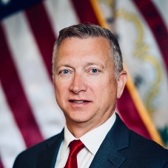













Advisory Panel Members
Katherine Calloway, D.O., MPH
President, WVRHA
Mark McDaniel, D.O., FAAFP
State Health Officer, WVDOH
Sarah Tucker
Chancellor, HEPC
John Cornell, M.D.
Associate Professor, Marshall Health
Rebecca McPhail
President, GO-WV
Trish Watson
Director/Paramedic, EMS Coalition
Nick Fantasia
President, Marion Regional Development Corporation
Heather Sigel
Vice President of Operations, Valley Health
Merinda Stricklen
Director, Health and Community Education, FamilyCare Health Centers, Co-Chair WV Food Is Medicine Coalition
Sherri Ferrell, MBA
CEO, Primary Care Association
Joshua Spence
CTO & Co-Founder, StitchAI
Ali Rezai, M.D.,
VP of Neuroscience, WVU Neuroscience
Jason Landers
Medicaid Market President, Highmark
Andy Tanner, D.O.,
Provider – Family Medicine, Vandalia
Virgil Underwood
President & CEO, Boone Health

Slide 16
Partner Expectations
Program Alignment / Impact
Alignment with West Virginia’s Health/MAHA Initiatives: All proposed activities must directly align with the State’s overarching health and wellness metrics and initiatives.
Focus on Rural Citizens: Deliver tangible benefits to the rural population of West Virginia.
Measurable Impact: Partners must demonstrate how their proposed activities will lead to measurable improvements in health outcomes (“move the needle”).
1
E.g., Implementation of a telehealth program in 3 rural counties (activity) is expected to reduce the average travel time for specialist appointments by 50% within the first year (outcome metric).
2
Target Population & Vendor Scope
Defined Target Population: Partners may focus on a specific, targeted population within the rural community.
Reporting & Sustainability
Federal Reporting Requirements: Partners must be able to meet all federal reporting requirements associated with the program.
Sustainability Plan: Partners must present a clear and actionable plan that begins execution of sustainable goals in Y3. Partners must also demonstrate how the project will be fully self-sufficient the funding period concludes in Y5.
3

Slide 17
Beyond the Initial Investment
West Virginia will prioritize proposals that include co-investment or a clear plan to secure private matching funds, with, in some cases, preference given to applicants offering a 1:1 match.
Connected Care Grid
Equip hub-and-spoke modelled grid
Fund telemedicine equipment and technology
Partners should expect a match requirement for the following initiatives with specific criteria to be determined and communicated via a formal solicitation:
Mountain State Care Force
Provide targeted incentives tied to a 5-year rural service commitment
Support career ladder advancement programs
Co-invest in additional training
Smart Care Catalyst
Establish productivity support fund
Provide implementation support to strengthen VBC participation
Personal Health Accelerator
Provide sub-grants to Community Health Centers, hospitals, payers, and other partners to integrate nutrition and exercise programs into patient care:
HealthTech Appalachia
Manage public-private investment fund

Slide 18
CMS Guidance & Funding Limitations
18

Slide 19


Stevens Amendment Guidelines
What is the Stevens Amendment?
A federal requirement for projects receiving funding from the U.S. Departments of Labor, Health and Human Services (HHS), and Education.
It mandates that all public communications (e.g., press releases, websites, and presentations) acknowledge the federal funding source.
The goal is to ensure that the role of federal funding in a project is transparent to the public.
Why Is It Important?
Public Transparency: It ensures that the American public can see how federal tax dollars are being spent.
Accountability: It holds grant recipients accountable for the federal funds they manage.
Public Awareness: It informs communities about the federally-supported programs and services available to them.
What Does the Disclosure Look Like?
The amendment requires a specific statement detailing the funding. The language is as follows:
“This project is supported by the [Federal Agency Name] of the U.S. Department of [Department Name] as part of a financial assistance award totaling [$Total Award Amount]. The contents are those of the author(s) and do not necessarily represent the official views of, nor an endorsement, by [Federal Agency Acronym], [Department Acronym], or the U.S. Government."

Slide 20
RHTP Fund Utilization
Guiding Principle(s) for RHTP Funds:
Funds should be directed towards activities that improve healthcare access, technology integration, and workforce capacity for rural* residents.
Terms and conditions of federal awards generally flow down to all subrecipients as well. In other words, all recipients of RHTP funds are bound by CMS contractual rules for spending and reporting. Any misuse of funds may require them to be returned.
CMS Allowable Use of Funds
Personnel and Staffing: This includes salaries and wages for staff involved in an approved initiative, provided the facility does not use non-compete clauses for clinicians.
Health Care Workforce Development: Activities focused on training, recruitment, and retention to attract and keep a high-skilled healthcare workforce in rural communities.
Collaboration and Outreach: Supporting partnerships between rural and non-rural entities to benefit rural residents, such as a non-rural hospital providing telehealth support to rural areas.
Technology: Fostering the use of innovative technologies that promote efficient care delivery, enhance data security, and improve access to digital health tools.
Minor Renovations: Funds may be used for minor renovations or alterations if they are directly linked to program goals and receive prior CMS approval. This is capped at 20% of the funding for a given budget period.
See NOFO, Program requirements and expectations, Use of Funds (pages 11-13), and Program-specific limitations, Unallowable Costs (pages 19-20) for more information (link: Rural Health Transformation Program).
Administrative Costs: Direct and indirect administrative costs are allowed but must be clearly identified and are limited to 10% or less of the total budget.
*RHT Program funds should be used to benefit the populations that the State has identified as rural, which may differ from HRSA definitions.

Slide 21
CMS Prohibited Uses*
Construction: Funding may not be used for new construction, building expansions, or significant cosmetic or structural upgrades that materially increase the value or useful life of a building.
Supplanting Existing Funds: RHTP funds cannot replace or substitute existing state, local, tribal, or private funding for ongoing infrastructure or services, such as staff salaries. The goal is to supplement, not supplant.
Duplicate Payments for Clinical Services: Funds cannot be used to pay for clinical services that could be reimbursed by insurance or to duplicate existing billable services.
Clinician Non-Compete Agreements: Funds cannot be used to pay salaries or wages for clinicians at facilities that require them to sign non-compete agreements.
General Prohibitions:
Lobbying or any activities designed to influence legislation.
Meeting matching requirements for other federal grants.
Costs incurred before the official award date.
Services that are the legal responsibility of another party (e.g., educational services, accommodations required by civil rights law).
Purchase of certain telecommunications and video surveillance equipment.
Financial assistance to households for internet costs.
Certain experimental or cosmetic procedures.
*Please refer to the NOFO for more details around prohibited uses of funds: Rural Health Transformation Program.

Slide 22
Noncompliance
Violations of the agreement include, but are not limited to, the following actions:
A state or its partners are considered in 'violation of agreement' if RHTP funds are not used in accordance with the approved application and program rules; such actions are subject to consequences for noncompliance.
Improper Use of Funds: Using award money for activities that are inconsistent with the state’s approved application or for activities that are explicitly listed as unallowable.
Failure to Act: Not completing the state policy actions that were proposed in the application by the end of the calendar year 2027. States will have until the end of calendar year 2028 to enact the relevant policies for factors B.2¹ and B.4.²
Lack of Broad Impact: Failing to invest funds in a way that benefits the state's rural areas and residents in a meaningful and positive manner.
Poor Management: Improperly managing or using award funds, which includes any fraud, waste, abuse, or criminal activity.
Failure to Report: Not submitting the required reports on time as outlined in the Reporting section of the agreement.
Violating Award Terms: Failing to adhere to the general terms and conditions of the RHTP award.
Not Following Through: Failing to complete other actions that were committed to in the state's approved application.
If CMS determines that a state is not in compliance, it has the authority to:
Withhold future funds.
Reduce the total award amount.
Recover award payments that have already been distributed.
¹ For State Policy Action Factor, factor captures whether a State requires schools to reestablish the Presidential Fitness Test. The Presidential Fitness Test must be reinstated in a way that is aligned with any announced federal guidance associated with Executive Order 14327.
² State to include in application whether a State has a requirement for nutrition to be a component of continuing medical education (CME)

Slide 23
Procurement & Grant Opportunities
23

Slide 24
Anticipated RHTP Solicitation Timeline
The following table provides a high-level timeline for the anticipated release of solicitations for various procurement opportunities within each initiative for Year 1. Please navigate to the Oasis site to learn more: wvOASIS.gov
Anticipated Timeline
Initiative | Pillar | March – April | May – June | July - September
Mountain State Care Force | Grow Local Talent Pipelines
 | Recruit and Retain Workforce
Connected Care Grid | Digital Backbone​
 | Build Network
 | Bring Market Access
SmartCare Catalyst | Reduce Provider Burden
HealthTech Appalachia | Incubate & Accelerate
Rural Health Link | Simplify Mobility
Health Accelerator | Local Health Improvement
Health To Prosperity | Help WV Work
While this timeline provides our current outlook, we are actively working to accelerate these dates. As such, it is possible solicitations will be issued ahead of the anticipated time outlined above.

Slide 25
How to Apply (Grants)
For additional information and to access the OASIS portal, please navigate to the WV RHTP website linked here: Rural Health Transformation Program | WV Department of Health
1
Find Opportunity: Locate the Announcement for Funding Availability (AFA) on the WV Oasis Vendor Self Service (VSS) portal, listed under “Grant Funding Opportunities.”
Determine Eligibility: Carefully read the AFA to confirm that your organization is eligible and to understand the intended use of the funds and other key requirements.
2
3
Submit Application: If eligible, complete and submit the grant funding application directly through the WVOasis VSS portal.
Await Award Notification: Once submitted, the application will enter the state’s review process. If successful, a grant award will be created and an agreement will be sent for signature.
4

Slide 26
How to Apply (Proposals)
For additional information and to access the OASIS portal, please navigate to the WV RHTP website linked here: Rural Health Transformation Program | WV Department of Health
1
Find Opportunity: Locate the Request for Proposal (RFP) on the WV Oasis Vendor Self Service (VSS) portal, where it is published for vendors.
Determine Eligibility: Carefully read the full RFP document to confirm that your organization is eligible and to understand the scope of work, technical requirements, and submission instructions.
2
3
Submit Proposal: For larger dollar procurements, bids are either submitted in the OASIS system (Requests for Quotation) or in hard copy (RFP, EOI).
Await Award Notification: Once submitted, the proposal will enter the state’s review process. If successful, an award will be issued through the portal.
4

Slide 27
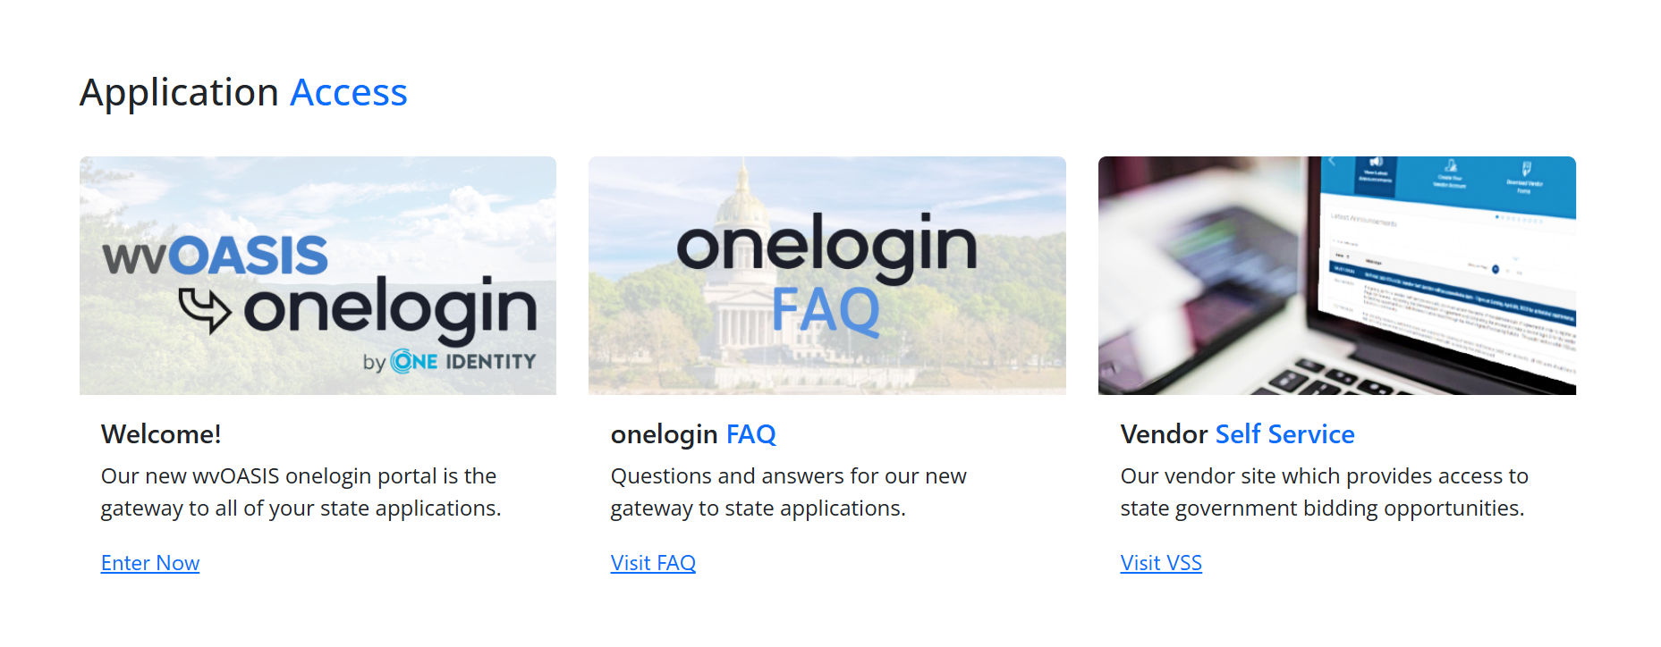
WV OASIS
Interested applicants should refer to the WVOasis website for all information regarding applications and procurements: wvOASIS.gov. The screenshot below provides an overview to the site’s primary menu options.
Check the status of your applications and receive relevant updates here.
Explore all available opportunities and begin the application process here.
27

Slide 28
How Success Will Be Measured Post-Selection
Core Project Evaluation Criteria
CMS Reporting Excellence: Demonstrate ability to provide timely, accurate, and compliant reporting that meets all CMS requirements.
Seamless Data Integration: Technical capability and commitment to integrate fully with the broader RHTP data spine, ensuring a unified and transparent data ecosystem across all program components.
Questions To Consider As Funds Are Being Implemented
Is the project implementation continuing to align with core RHTP initiatives?
Are decisions positively contributing to the project’s long term financial sustainability and how do these decisions impact the potential to scale over time?
Are there any opportunities to more quickly implement aspects of the program and how will it impact performance?
How is the project tracking against target metrics? Have necessary CMS reporting metrics been maintained?

Slide 29
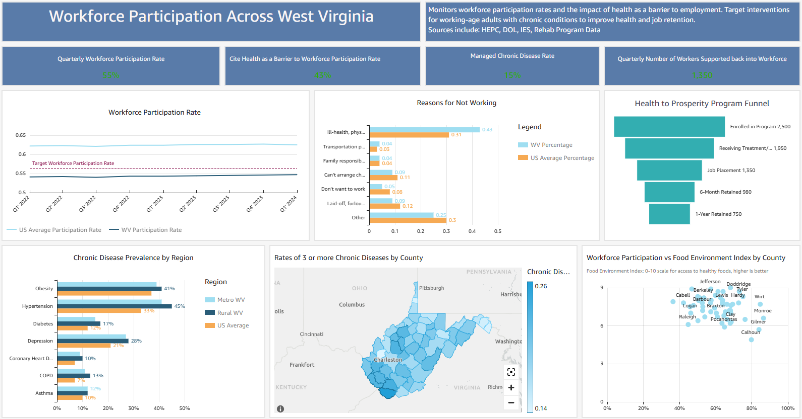
Sample Reporting Dashboards

Slide 30
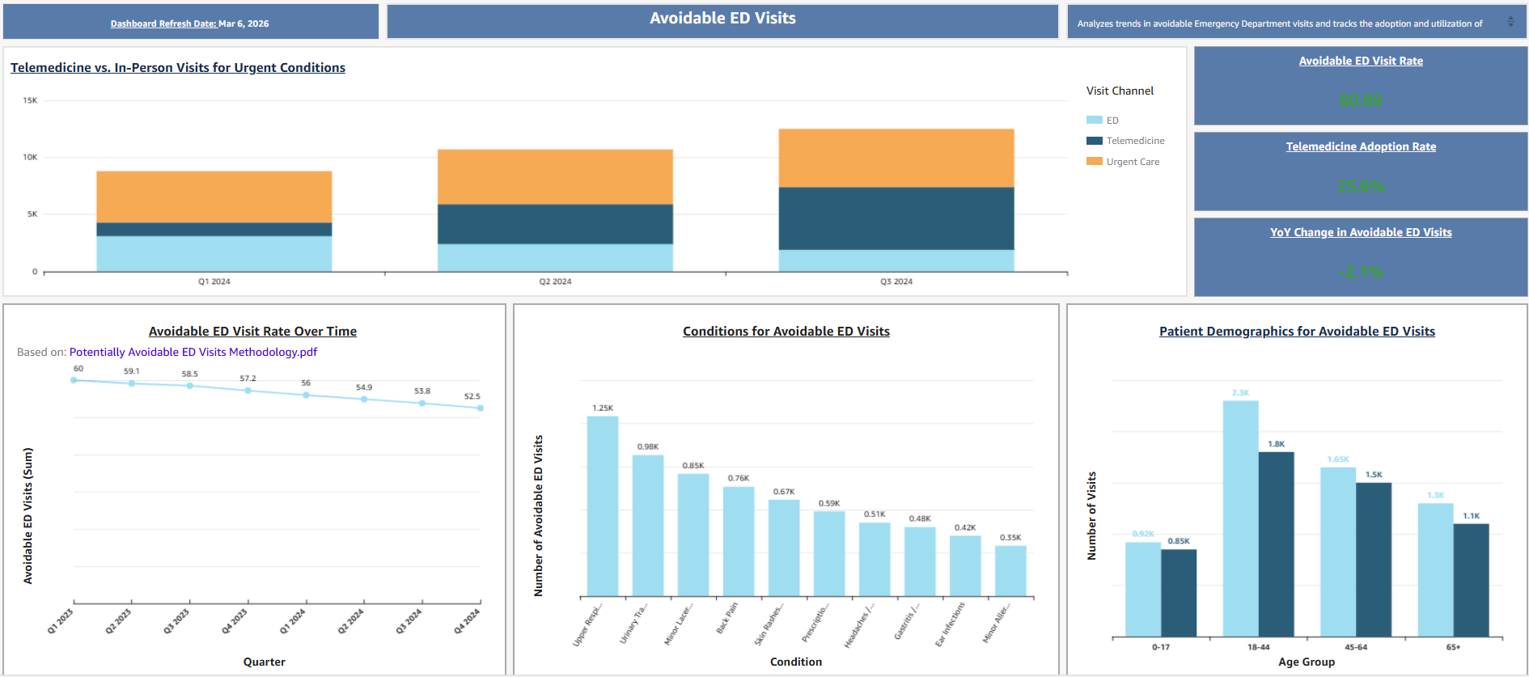
Sample Reporting Dashboards Cont.

Slide 31
Closing Call To Action
31

Slide 32
Closing Call to Action – How West Virginians Can Participate
We will maintain transparency in our communications with all stakeholders as the Program progresses. You may find all RHTP news, updates, and resources on our program website: Rural Health to Transformation Program | WV Office of the Governor Patrick Morrisey.
Future Solicitations
Keep an eye out for upcoming Request for Proposals (RFP) and grant announcements. We will be seeking partners to help us build a better healthcare future for rural West Virginians.
Register as a Vendor
To be eligible for contracting opportunities, register your organization in the WVOasis vendor system. This is a crucial step to ensure you are ready when announcements are made.
Stakeholder Meetings
Attend our upcoming stakeholder meetings to learn more about the RHTP, ask questions, and provide your valuable feedback.
RHTP Listserv
Stay up-to-date with the West Virginia RHTP by signing up for our listserv to get the latest announcements, updates, and information sent directly to your inbox.

Slide 33
Q&A
Scan the QR code below to submit your questions for the Q&A:
33

